Slide 1

Air Pollution and Respiratory Diseases
GROUP MEMBERS: Jessica E, Ariana G, Loraine G, Paul S, Deborah D

Slide 2
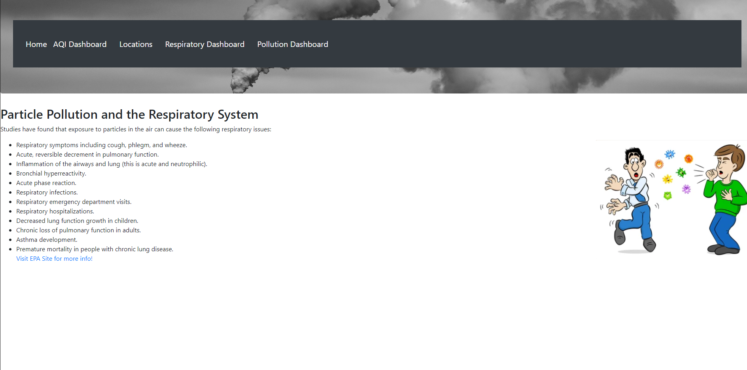
Home Page:
Gives a list of respiratory illnesses and diseases that can be caused by air pollution.
Navigation Bar showcases different charts of data.

Slide 3
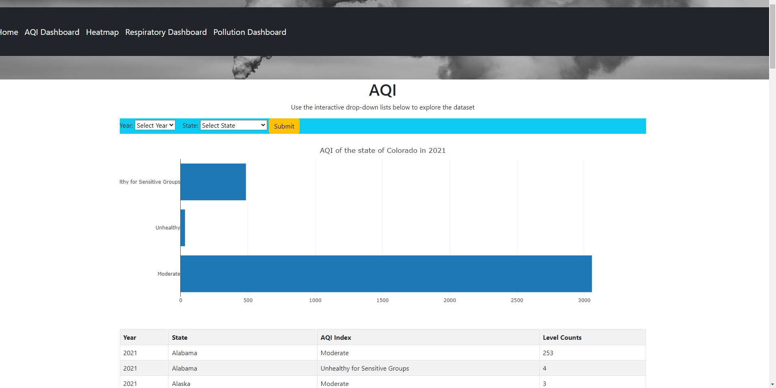
The AQI Dashboard Menu Option redirects to the Plotly interactive map that allows a user to select a year and state to discover how many hours in that year the air quality fell into the various AQI index categories.

Slide 4
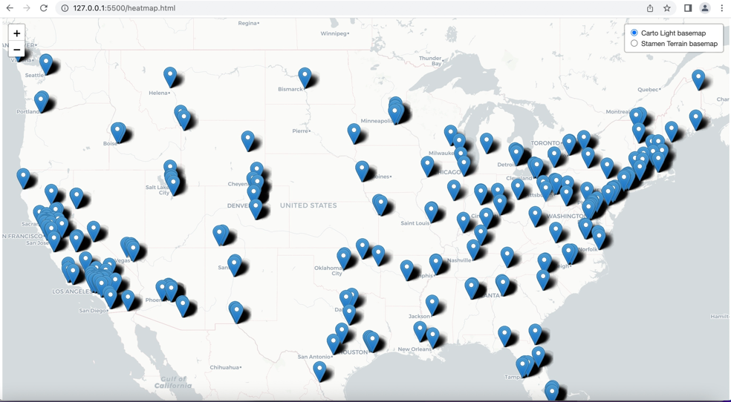
The Location menu item will take the user to a map of U.S., displaying where air quality is located.

Slide 5
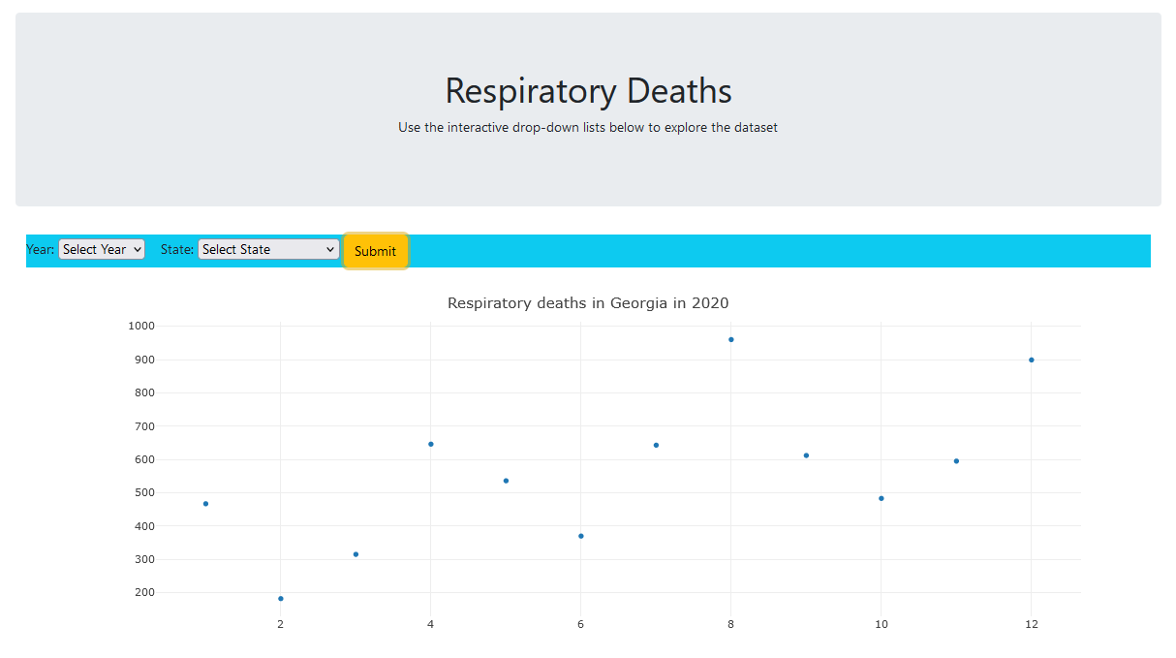
The Respiratory Dashboard Menu option redirects to a Plotly chart that displays the count of all respiratory deaths in a selected year within a selected state from 2020 to 2022.

Slide 6
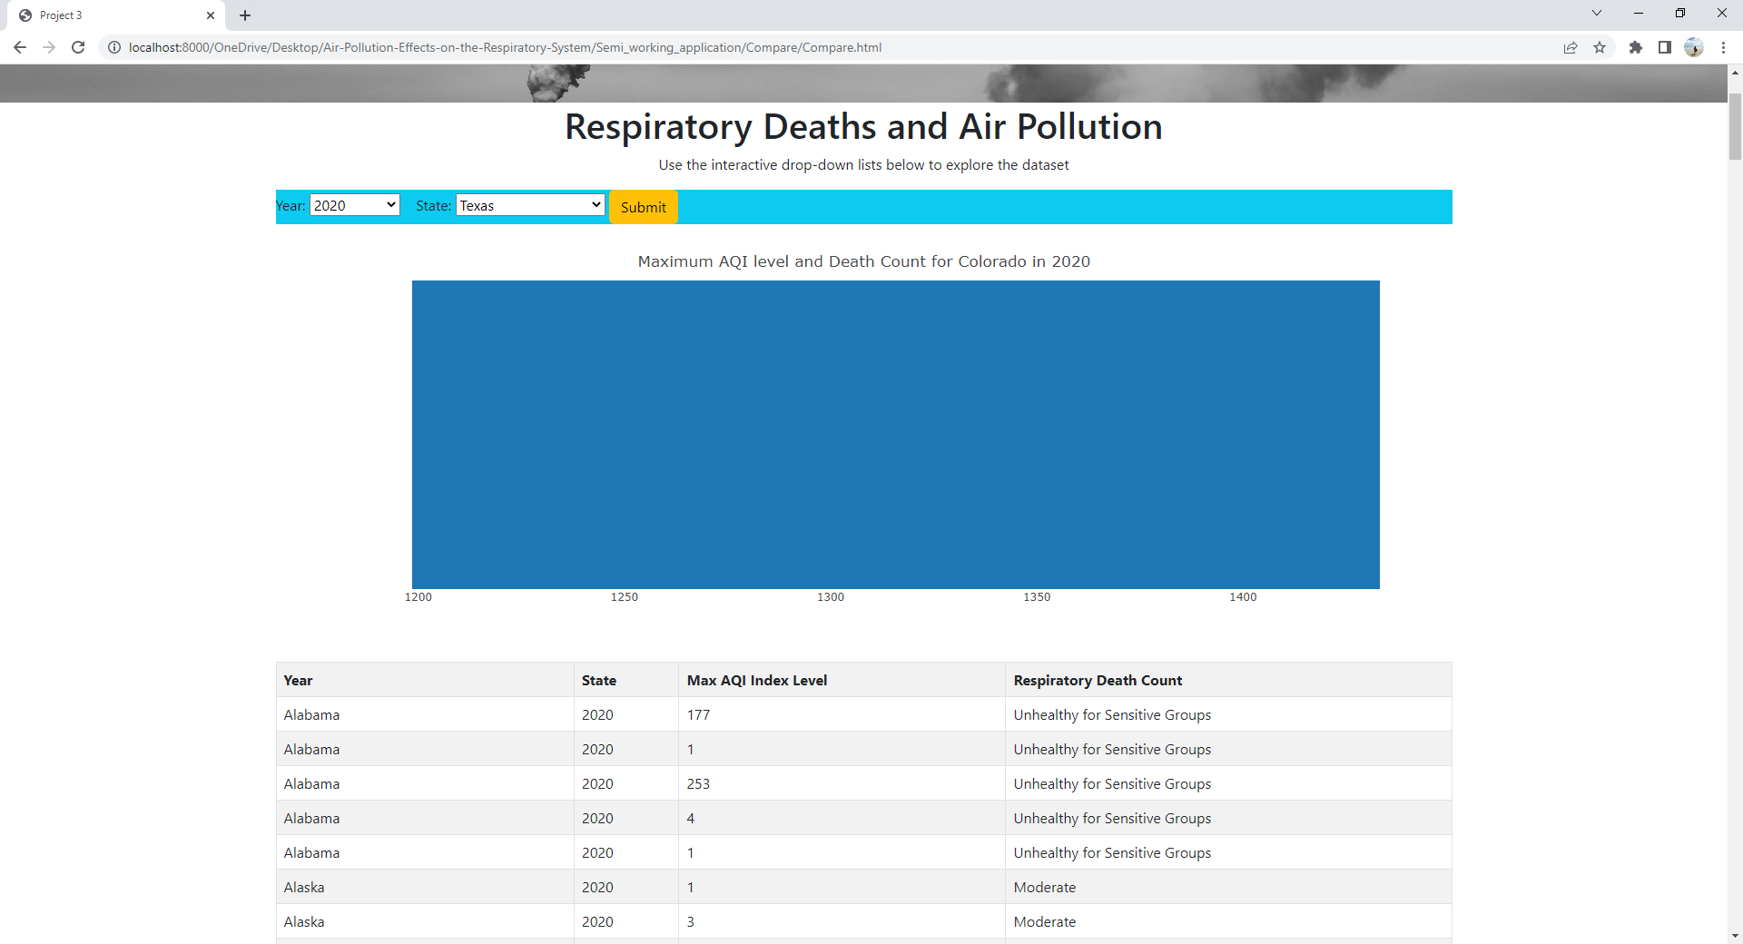
The Pollution Dashboard Menu option redirects to a Plotly chart that displays the health levels in air quality and respiratory death counts by making a selection for the year and state from 2020 to 2022.

Slide 7
SOURCES:

